Slide 1
SIC030 - PPT - SESI ke 2 Sistem Perdagangan Elektronik
Pengantar Perdagangan Elektronik :
Kerangka dasar dan jenis EC
M HANIF JUSUF ST MKOM

Slide 2
Learning Objectives
Define electronic commerce (EC) and describe its various categories.
Describe and discuss the content and framework of EC.
Describe the major types of EC transactions.
Describe some EC business models.

Slide 3
Learning Objectives (cont.)
Describe the benefits of EC to organizations, consumers, and society.
Describe the limitations of EC.
Describe the role of the digital revolution in EC.
Describe the contribution of EC to organizations responding to environmental pressures.

Slide 4
The EC Framework, Classification, and Content
Two major types of e-commerce:
business-to-consumer (B2C) : online transactions are made between businesses and individual consumers
business-to-business (B2B): businesses make online transactions with other businesses
intrabusiness EC: EC conducted inside an organization (e.g., business-to-employees B2E)

Slide 5
The EC Framework, Classification, and Content (cont.)
Computer environments
Internet: global networked environment
Intranet: a corporate or government network that uses Internet tools, such as Web browsers, and Internet protocols
Extranet: a network that uses the Internet to link multiple intranets

Slide 6
EC Framework
EC applications are supported by infrastructure and by five support areas:
People
Public policy
Marketing and advertising
Support services
Business partnerships

Slide 7
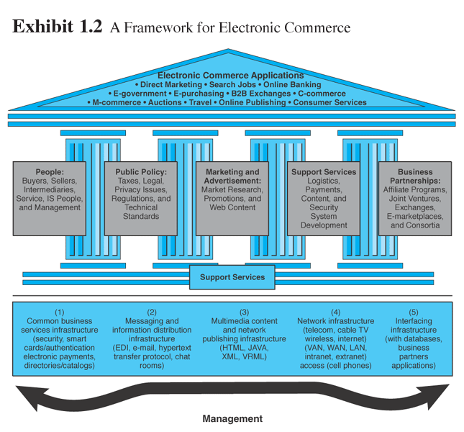
Exhibit 1.2: A Framework for Electronic Commerce

Slide 8
Classification of EC by Transactions or Interactions
business-to-consumer (B2C) : online transactions are made between businesses and individual consumers
business-to-business (B2B): businesses make online transactions with other businesses
e-tailing: online retailing, usually B2C

Slide 9
Classification of EC by Transactions or Interactions (cont.)
business-to-business-to-consumer (B2B2C): e-commerce model in which a business provides some product or service to a client business that maintains its own customers
consumer-to-business (C2B):
e-commerce model in which individuals use the Internet to sell products or services to organizations or individuals seek sellers to bid on products or services they need

Slide 10
Classification of EC by Transactions or Interactions (cont.)
consumer-to-consumer (C2C):
e-commerce model in which consumers sell directly to other consumers
peer-to-peer (P2P): technology that enables networked peer computers to share data and processing with each other directly; can be used in C2C, B2B, and B2C e-commerce

Slide 11
Classification of EC by Transactions or Interactions (cont.)
mobile commerce (m-commerce):
e-commerce transactions and activities conducted in a wireless environment
location-based commerce (l-commerce): m-commerce transactions targeted to individuals in specific locations, at specific times

Slide 12
Classification of EC by Transactions or Interactions (cont.)
intrabusiness EC: e-commerce category that includes all internal organizational activities that involve the exchange of goods, services, or information among various units and individuals in an organization
business-to-employees (B2E): e-commerce model in which an organization delivers services, information, or products to its individual employees

Slide 13
Classification of EC by Transactions or Interactions (cont.)
collaborative commerce (c-commerce):
e-commerce model in which individuals or groups communicate or collaborate online
e-learning: the online delivery of information for purposes of training or education
exchange (electronic): a public electronic market with many buyers and sellers

Slide 14
Classification of EC by Transactions or Interactions (cont.)
exchange-to-exchange (E2E): e-commerce model in which electronic exchanges formally connect to one another the purpose of exchanging information
e-government: e-commerce model in which a government entity buys or provides goods, services, or information to businesses or individual citizens

Slide 15
The Interdisciplinary Nature of EC
Major EC disciplines
Computer science
Marketing
Consumer behavior
Finance
Economics
Management information systems

Slide 16
A Brief History of EC
1970s: innovations like electronic funds transfer (EFT)—funds routed electronically from one organization to another (limited to large corporations)
electronic data interchange (EDI)— electronically transfer routine documents (application enlarged pool of participating companies to include manufacturers, retailers, services)
interorganizational system (IOS)—travel reservation systems and stock trading

Slide 17
A Brief History of EC (cont.)
1969 U.S. government experiment—the Internet came into being initially used by technical audience of government agencies, academic researchers, and scientists
1990s the Internet commercialized and users flocked to participate in the form of dot-coms, or Internet start-ups
Innovative applications ranging from online direct sales to e-learning experiences

Slide 18
A Brief History of EC (cont.)
Most medium- and large-sized organizations have a Web site
Most large U.S. corporations have comprehensive portals
1999 the emphasis of EC shifted from B2C to B2B
2001 the emphasis shifted from B2B to B2E,
c-commerce, e-government, e-learning, and
m-commerce
EC will undoubtedly continue to shift and change

Slide 19
A Brief History of EC (cont.)
EC successes
Virtual EC companies
eBay
VeriSign
AOL
Checkpoint
Click-and-mortar
Cisco
General Electric
IBM
Intel
Schwab
EC failures
1999, a large number of EC-dedicated companies began to fail
EC’s days are not numbered!
dot-com failure rate is declining sharply
EC field is experiencing consolidation
most pure EC companies, are expanding operations and generating increasing sales (Amazon.com)

Slide 20
The Success Story of Campusfood.Com
Provide interactive menus to college students, using the power of the Internet to replace and/or facilitate the traditional telephone ordering of meals
Built the company’s customer base
expanding to other universities
attracting students
generating a list of restaurants from which students could order food for delivery

Slide 21
The Success Story of Campusfood.Com (cont.)
Now some of these activities are outsourced to a marketing firm, enabling the addition of dozens of schools nationwide
Financed through private investors, friends, and family members, the site was built on an investment of less than $1 million
Campusfood.com’s revenue is generated through transaction fees—the site takes a 5 % commission on each order from the sellers

Slide 22
The Success Story of Campusfood.Com (cont.)
At campusfood.com you can:
Navigate through a list of local restaurants, their hours of operation, addresses, phone numbers, etc.
Browse an interactive menu
Bypass “busy” telephone signals to place an order online
Access special foods, promotions, and restaurant giveaways
Arrange electronic payment of your order

Slide 23
The Future of EC
2004—total online shopping and B2B transactions in the US between $3 to $7 trillion by 2008:
number of Internet users worldwide should reach 750 million
50 percent of Internet users will shop
EC growth will come from:
B2C
B2B
e-government
e-learning
B2E
c-commerce
the future is bright

Slide 24

Selesai

